Slide 1
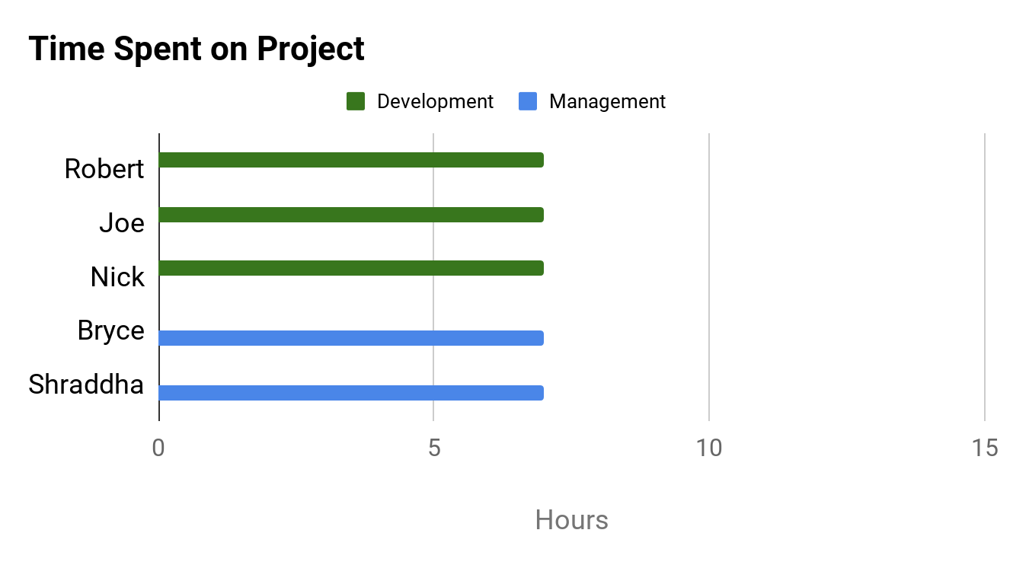
PROJECT DASHBOARD: HAX CMS MICROSERVICE
TEAM: #1
DATE: 29-MAR-2020
COMPLETED TASKS
On Target | At Risk | Attention Needed | Not Applicable
PROJECT STATUS
KEY PERFORMANCE INDICATORS
Troubleshooted Docker container build
Distributed general tasks for Final Report
Tested conversions between various file types
On Target | At Risk | Attention Needed | Not Applicable
Overall: On Target
Time: On Target
CURRENT TASKS
Scope: On Target
Continue development stage
Identify bugs in code
Establish types of use cases across various users
Give option to save converted file in specific location
Cost: No Budget
RISK STATUS
Task | Progress
Development Work
Identify Bugs in Code/Create Tests
Establish Use Cases of Different Users
On Target | At Risk | Attention Needed | Not Applicable
Risk 1: Time Constraints
50%
ISSUES NEEDING ATTENTION
Risk 2: Lack of Development Support
No issues at this time
Risk 3: GitHub Change Compatibility
15%
Risk 4: Stray from Original Scope
10%
Risk 5: Remote Collaboration

